Slide 1
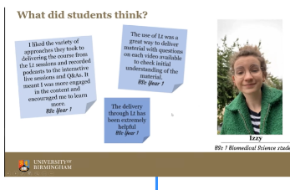
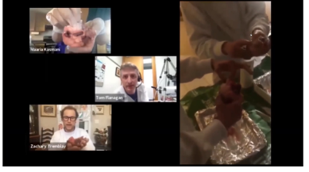
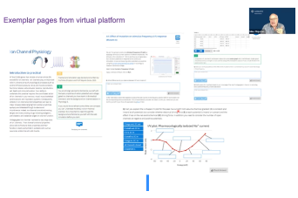
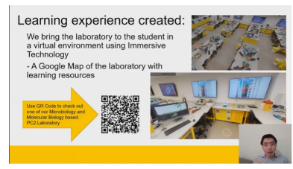
Biomedical Sciences
First meeting of the Biomedical Sciences strand at an annual meeting
Small group attended (to be expected)
Fascinating series of talks on the virtual teaching of laboratory skills
Discussion on pandemic and (hopefully) post-pandemic teaching of labs
  How much do we keep online?
  Do we still use hybrid teaching?
  Possible collaborations across the network to develop online lab skills material
  Can we teach lab skills remotely to LMIC?

