Slide 1

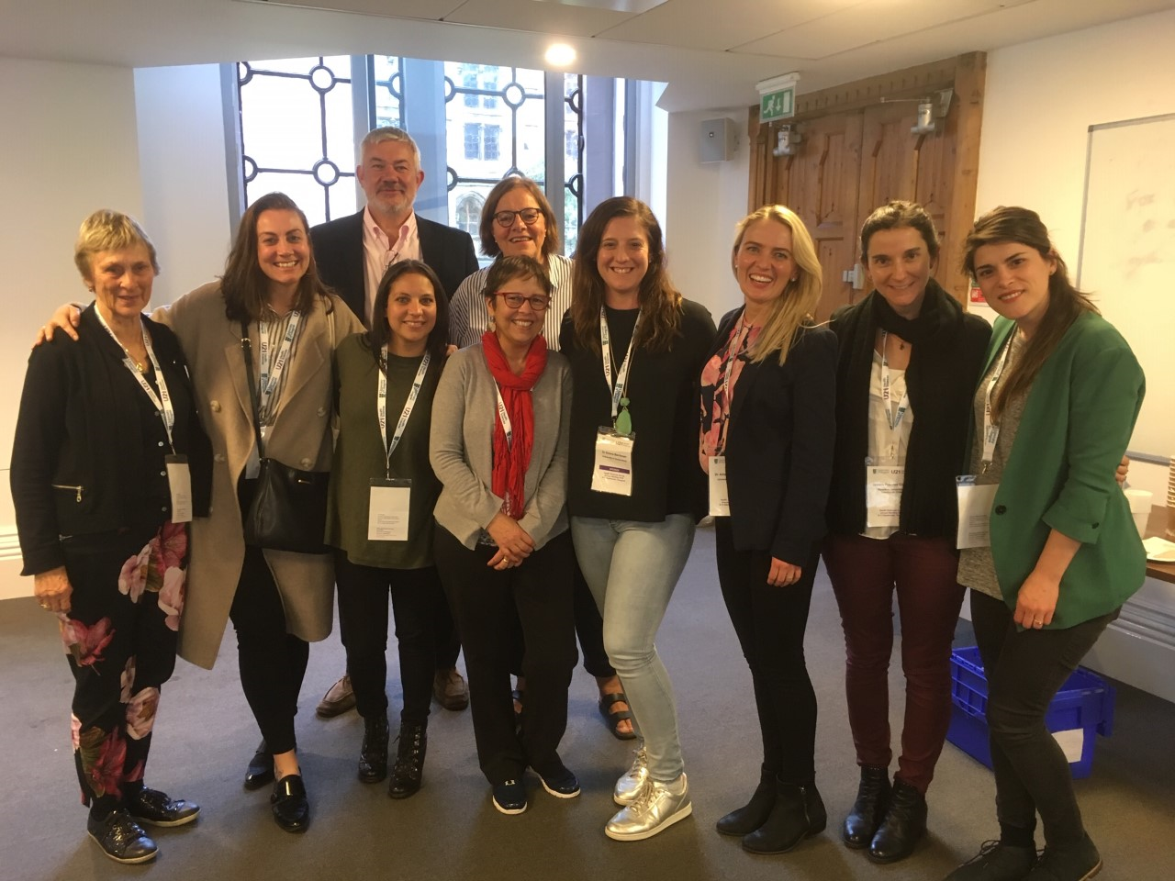

Digital learnings for a post-covid world
U21 Health & Rehabilitation Sciences - Core group members 2021
Chair; Physiotherapy, UQ | Allison Mandrusiak
Human Movement & Nutrition Sciences, UQ | Emma Beckman
Physiotherapy, Lund | Susanne Brokop
Physiotherapy, Chile | Javiera Fuentes
Biokinetics, Johannesburg | Lynn Smith
HRS Discipline Group Meeting:
Invited presentation: Developing the Global Health Challenges Digital Module (Ben Ellis, UoB).
Ben showcased resources developed as part of this excellent, collaborative project, funded by U21 GEEF.
Tradeshow: 4 HRS members shared strategies in our digital toolkits, including innovative ways to use Zoom, Discussion Boards, and online feedback tools; this stimulated discussion and sharing of tips and tricks to engage students during and beyond Covid disruptions.
a.mandrusiak@uq.edu.au (Allison, Chair)

